Slide 1
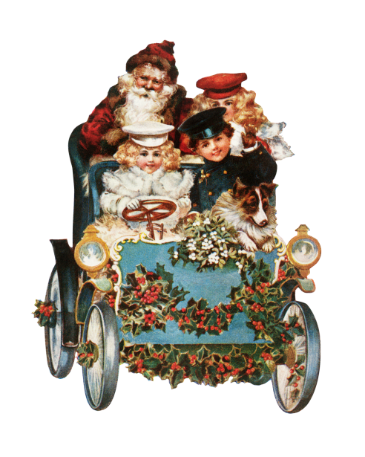
Library hours open from 7:50-3:30pm
Horario de la biblioteca abierto
de 7:50-3:30pm
It’s story time with Mrs. Rebia!
Just click on the titles below

